Slide 1
Mountain Navigation Basics
Steven McDonald
International Mountain Leader
BASI ISTD Snowboard Instructor

Slide 2
Aims for the Course
Accurate navigation in the mountains above all takes practise.
Provide a toolkit for navigating in good & bad visibility
Know where you are
Know where you’re going
Know which direction to travel in
Know how far it is to your destination
Know how long it should take to get there
Keep track of the distance travelled

Slide 3
Reading the map - contours
Generally 10m intervals on French and UK OS maps – note some French maps use 20m contours (e.g. La Grave) and cross-border regions often use 20m intervals
Thick contours at 50m intervals
Shape of the lines shows the shape of the hillside, with practise it’s easy to picture the hillside based on the map
Great for poor conditions navigation – paths, streams, vegetation, buildings, signposts may all be hidden by snow, but the contours will stay the same

Slide 4
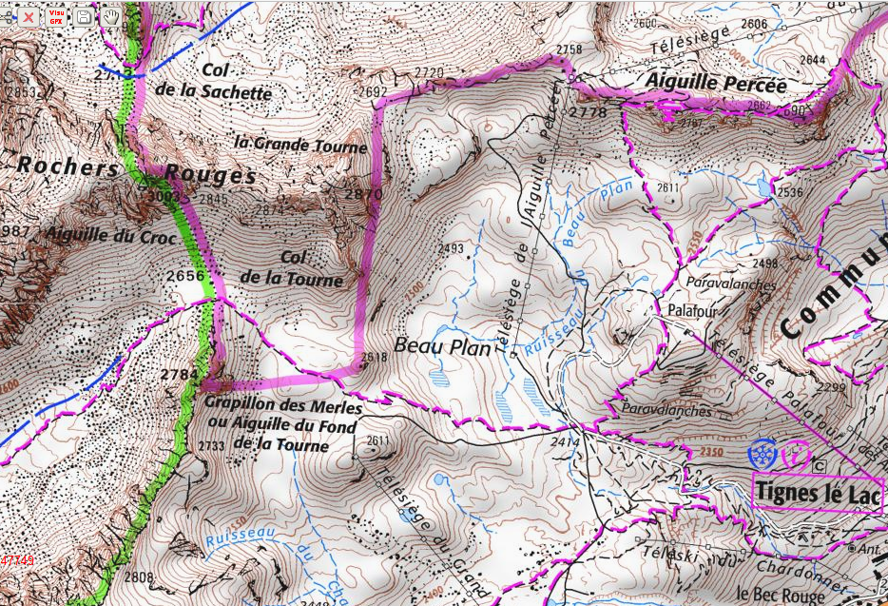
Reading the map - contours
Col (saddle, pass)

Slide 5
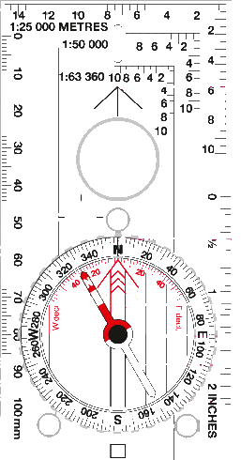
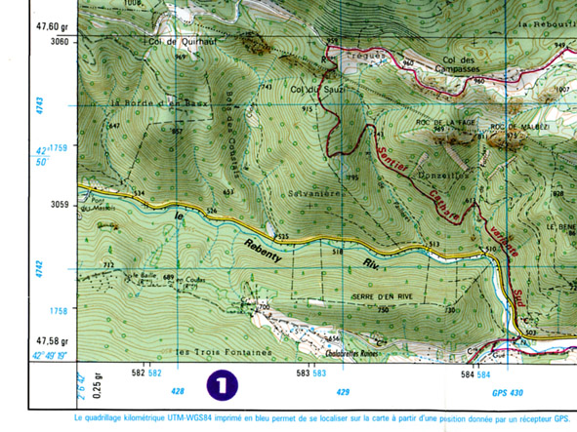
Reading the map – grid references
UK 6-figure grid ref
Along, then up
Divide square into 10ths
Meall Mor summit is at 106559
(full reference NN106559 where
NN is 100km square)
Accurate to 100m
French 10-figure+ GPS ref
Along, then up
Divide each square into 1000ths
Roc de la Fage is at 429664 4742851 (GPS)
Or 429600474800 (read from map)
_{Accurate to 1m}
What’s the grid reference….
Here
Top of the 3rd lift at Sainte Foy
Summit of La Grande Motte
Petit Saint Bernard Hospice
330800 5053360
338245 5048680
3333605030820
334550 5059755
10
11

Slide 6
Reading the map - distance
Each square is 1km
Estimate shorter sections or measure with ruler or compass roamer
Use the distance to calculate time to walk section
Add sections to give total journey time
How far from here to Breuil church?

Slide 7
How long will it take?
Distance
A fair walking pace on mountain terrain is 4kph, so 1km takes 15mins
At 5kph (brisk walk), 1km takes 12mins
At 3kph (rough ground, snowshoeing), 1km takes 20mins
Height gain
Climbing adds to the time required
To climb 1 contour (10m) per minute, means climbing 600m per hour. This is FAST
A steady pace is around 300m per hour, or 2 mins per contour
E.g. Height gain from top of 3rd to summit of Fogliettaz is 300m. Most people take around 1hr, i.e. 300m per hour
Ski-touring
Rules of thumb above apply reasonably well to ski-touring in good conditions
Snowshoeing slower
Boot-packing very slow!

Slide 8
How long will it take?
Flat ground – use distance/speed to estimate time
Steep ground – use rate of climb to estimate time
Intermediate or undulating ground – need to use a combination
Downhill – use flat ground speed, reduce to 3kph if very steep
Naismith’s Rule
Usually given as 5kph + 1 minute per contour – usually optimistic
4kph + 1 minute per contour often more accurate

Slide 9
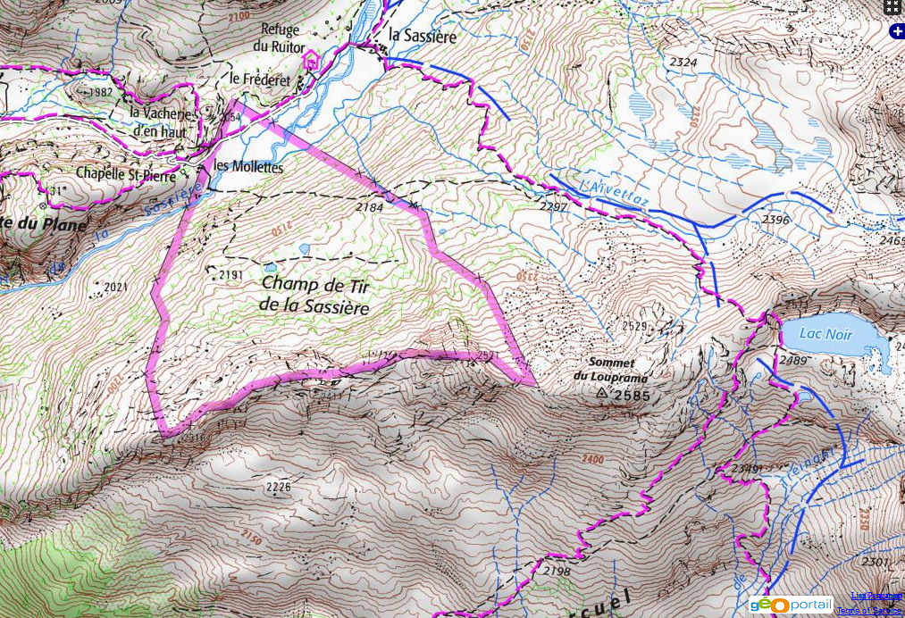
Distance/timing exercise
How long to walk from Chappelle Sainte Pierre to Refuge de l’Archeboc?

Slide 10
Keeping track of Distance
It’s important to be able to keep track of how far you have travelled if visibility is poor
If you have made a good estimate of the time required to cover the next section, then simply keeping track of time will give you a reasonable estimate of distance
You can track distance more accurately by counting paces – it helps to have some sort of counting help to stop you losing track (putting a pebble in your pocket every 100m will do!)

Slide 11
Using a compass – setting the map
Set your compass due North
Place the compass on the map and line up the edge of the compass (or the printed lines) with the north-south grid-lines on the map
Lay the map flat and rotate it until the red end of the compass needle lines up with the red-arrow on the base (put the red in the bed)
You can also set the map without the compass, using visible landmarks (if you know where you are!)

Slide 12
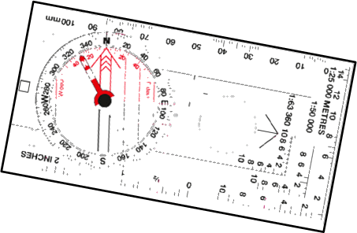
Using a compass – taking a bearing
Line up the printed line or the edge of the compass from point A to Point B
Rotate the compass bevel so that the lines on the bevel are aligned with the North-South grid
Read your bearing at the top
Double check by removing the compass and guesstimating the bearing by eye – it’s to be 180° out
A
B

Slide 13
Using the compass – taking a bearing
What’s the bearing from:
Top of the 3rd lift at Sainte Foy to Pointe de la Foglietta
Here to le Loissel
Top of le Grande Motte to Refuge de la Leisse
Petit Saint Bernard Hospice to Col de la Traversette
49°
129°
170°
179°

Slide 14
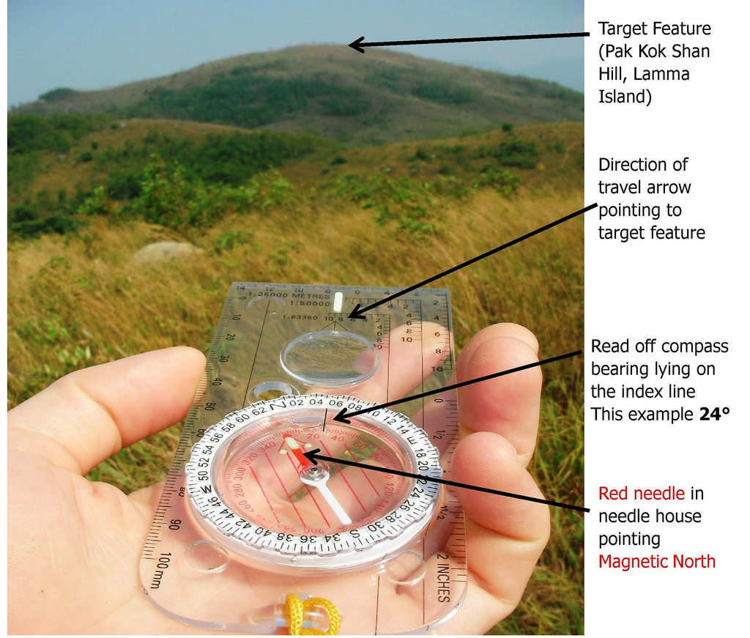
Using the compass – taking a bearing
To check the identity of a feature or help find your position, it can be useful to take a bearing on a real feature and refer back to the map
What’s the bearing from here to Le Loissel?

Slide 15
Using the compass – using the bearing
You are on the path from Tignes le Lac to Col de la Tourne, but you’re not sure exactly where
You take a bearing of 30° to the top of the Aiguille Percee chair
Lay the compass on the map and line up the edge with the top of the chair and the bezel lines with the north-south grid
You are at point A
30°
A

Slide 16
Using the compass – Aspect of Slope
The aspect of slope is the direction it faces. In fig. 33, the aspect of slope A-B is about 330°
Imagine you are on an open hillside in poor visibility (or in trees). You are not sure where you are and you need to reach a safe exit point, avoiding a cliff band
Use your compass to take a bearing straight down the hill
Lay the compass on the map, line-up the bezel lines with the north-south grid.
Slide the compass around until the long edge crosses the contours at 90°
In figure 34, you are somewhere on the line A-B, not the line X-Y
Combined with an Altimeter, you can get a very accurate position (e.g. if your altimeter is reading 850m, then you are here:
A similar technique also works with paths, useful in forests

Slide 17
Walking on a Bearing
When visibility is bad, you can take a bearing from the map then walk, following the compass arrow to reach your target.
These tactics can be helpful:
Tick points – make a (mental) list of features you should expect to cross as you follow your bearing. These should reassure you that you’re following the correct route
Aiming off (next slide)
Attack-point – choose a feature which is very easy to find (e.g. a summit) close to your destination, then you have a much shorter distance to micro-navigate

Slide 18
Aiming Off
You’re riding the Col Granier at Sainte Foy in bad weather. You’ve traversed round and found the entrance, then dropped down the main couloir, following the left-hand edge. You know where you are, but the weather is getting worse and you need to safely find the dam/bridge across the river.
Aiming straight for it means that just a small error means you could end up by the river not knowing if the dam is upstream or downstream of you (and also end up in dangerous ground downstream of the dam).
By deliberately « aiming-off » on the upstream side, you can then easily and safely follow the river (a « catching feature ») downstream to find the dam.
Direct bearing
Aiming off

Slide 19
Other Tools
GPS
GPS is awesome! However, it remains a battery-powered piece of electronics. When it’s all gone wrong, you’ve been out much longer than planned, it’s dark, cold and wet is when it’s most likely to fail!
Dedicated devices better than smartphone (battery life, waterproof)
iPhone apps: Tom’s Trails, iPhiGenie
Altimeter
Generally reliable, as long as you calibrate it regularly
Combined with a linear feature, slope aspect, etc. can give your position very accurately
Gives you some warning of changing weather

Slide 20
Further Reading
Mountain Navigation, Peter Cliff
Hill Walking, Steve Long (ML Handbook)
Mountaineering – The Freedom of the Hills, Steven Cox & Kris Fulsaas
Mountaincraft & Leadership – Eric Langmuir

